Slide 1

Deep Learning-Based Waste Material Classification Using EfficientNetB0
By Vrithik Sibbadi
Instructor: Chaojiang (CJ) Wu
Date: April 29, 2025

Slide 2
Introduction
Deep learning revolutionized waste classification.
Manual sorting: Time-inefficient, error-prone.
Goal: Automatic sortxing using EfficientNetB0 on TrashNet.

Slide 3
State-of-the-Art Deep Learning Models
Evolution: AlexNet → VGG → ResNet
EfficientNet: Compound scaling (depth, width, resolution)
EfficientNetB0: Best performance vs resources.

Slide 4


Literature Review – Techniques
Early: Manual feature engineering
CNN Revolution: VGGNet, ResNet, EfficientNet
Trends: Data augmentation, Vision Transformers, GANs.

Slide 5
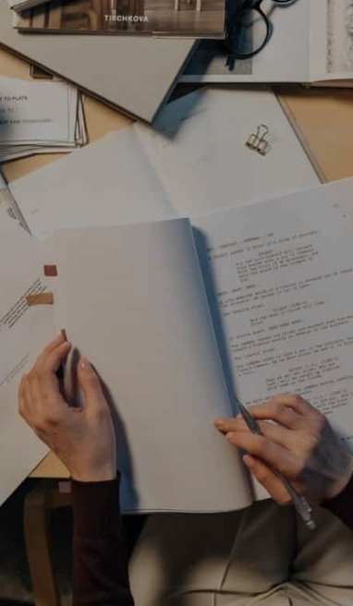
Literature Review – Challenges
Small datasets limit generalization
CNNs are black-box models
Real-time deployment challenges
Poor performance on novel waste types.

Slide 6
Industrial Applications
Smart waste systems
Healthcare: Disease detection
Transportation: Object detection
Security: Surveillance and threat detection.

Slide 7
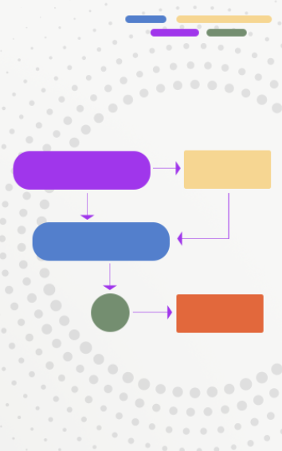
Dataset Overview
Dataset: TrashNet
2,500 labeled images (6 classes)
Train: 2024 | Validation: 503
Resized to 224x224 pixels.

Slide 8
Methodology
Preprocessing: Normalization, flip, rotate, zoom
Model: Pre-trained EfficientNetB0 + classifier
Training: Adam optimizer, EarlyStopping, 10 epochs.

Slide 9

Evaluation Results
Validation Accuracy: 23.46%
Severe underfitting
Heavy class confusion, bias towards 'paper'.

Slide 10
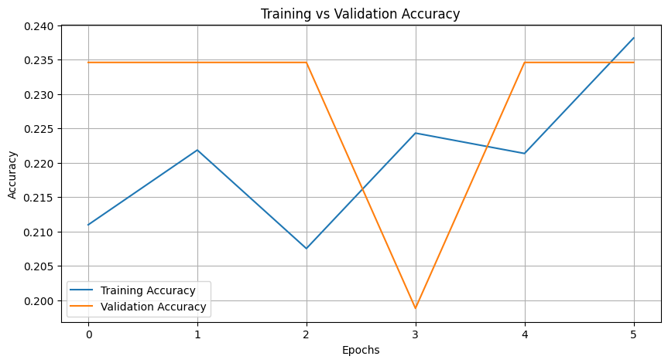
Training vs Validation Accuracy
Flat curves over epochs
Indicates underfitting and insufficient learning.

Slide 11
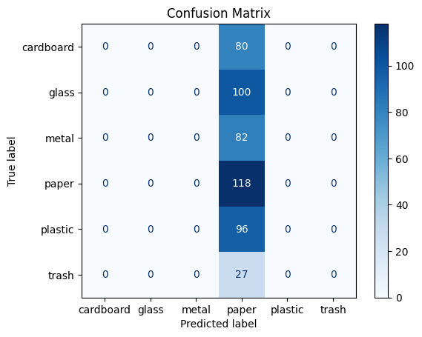
Confusion Matrix
High confusion across all waste categories
Model heavily biased toward 'paper'.

Slide 12

Limitations
Small and imbalanced dataset
No fine-tuning
Computational challenges
Low interpretability.

Slide 13

Future Work
Expand dataset
Fine-tune EfficientNet layers
Advanced augmentation (AutoAugment)
Edge deployment and explainability (Grad-CAM).

Slide 14
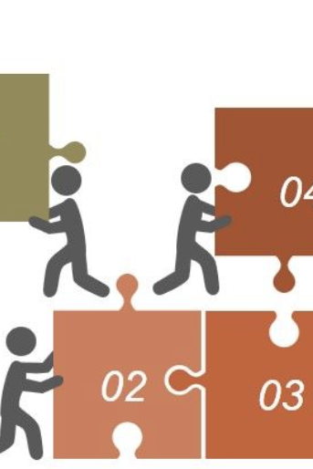
Potential Solutions
Selective unfreezing of layers
GANs for data synthesis
Model pruning and quantization
Shift to object detection (YOLO).

Slide 15

Conclusion
Critical for smarter waste management
Need better data, augmentation, fine-tuning
Future: Smarter, greener cities.

Slide 16

References
Tan & Le (EfficientNet)
He et al. (ResNet)
Thung & Yang (TrashNet)
Selvaraju et al. (Grad-CAM)
Redmon & Farhadi (YOLO)
Goodfellow et al. (GANs)
Dosovitskiy et al. (ViTs)

